Slide 1
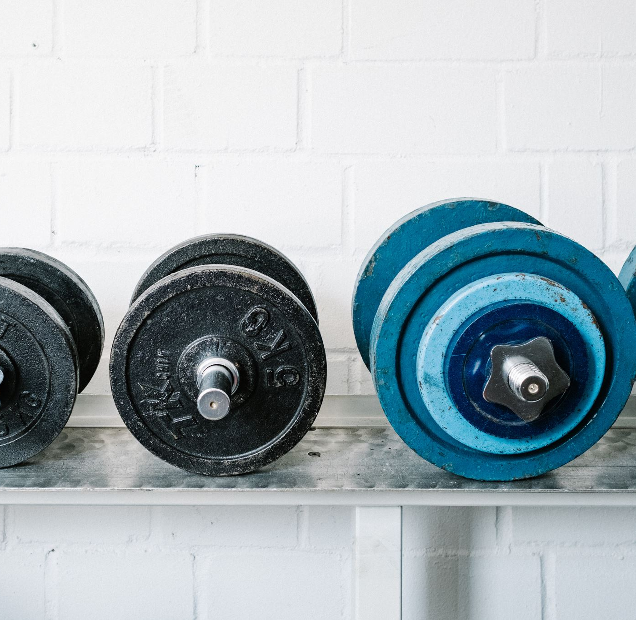
FITNESS GYM MANAGEMENT SYSTEM

Slide 2

INTRODUCTION:
Gyms are become the essential part of our lives, providing best exercise and body
building facilities to our society. Therefore, at the management end there are some necessary steps to maintain the records of every individual including trainer, trainees, and staff But maintaining the records on paper is very difficult So, it is necessary to have a computerized system that manages all these issues.
Thus working on the management system for Gym Industry are the basis of our project. We have developed an automated version of the manual system, named as Gymnasium Management System. This system also provides excellent security of data at to its user.

Slide 3







Project scope:
The administrator has the full fledged rights over this system.
The admin can make announcement about any thing.
Customer can contact with the admin .
Customer can avail the diet plan of their own desire.
Customers can Register for Gym
Customer can start plans
Customer can explore about Gym

Slide 4
Project Goal:
To remove the manual or paper work in the Fitness club.
Provide a platform with interactive user interface for both customer and admin.
Save the time of both admin and customer.
Get online plans in effective manners.
To save cost of each user.
The one who cannot afford gym packages ,also get benefits by viewing different exercise , diet plan tutorials.
User friendly.

Slide 5
Software Tools & Techniques
TOOLS:
Visual Studio Code
TECHNIQUES:
HTML
CSS
JavaScript

Slide 6
Modules:
Admin
Customer
Register
Trainer module
Contact us
Start plans
Explore

Slide 7
Functionality performed by admin
Login
Manage user
Message box
Trainer data
Diet plan
Contact us

Slide 8
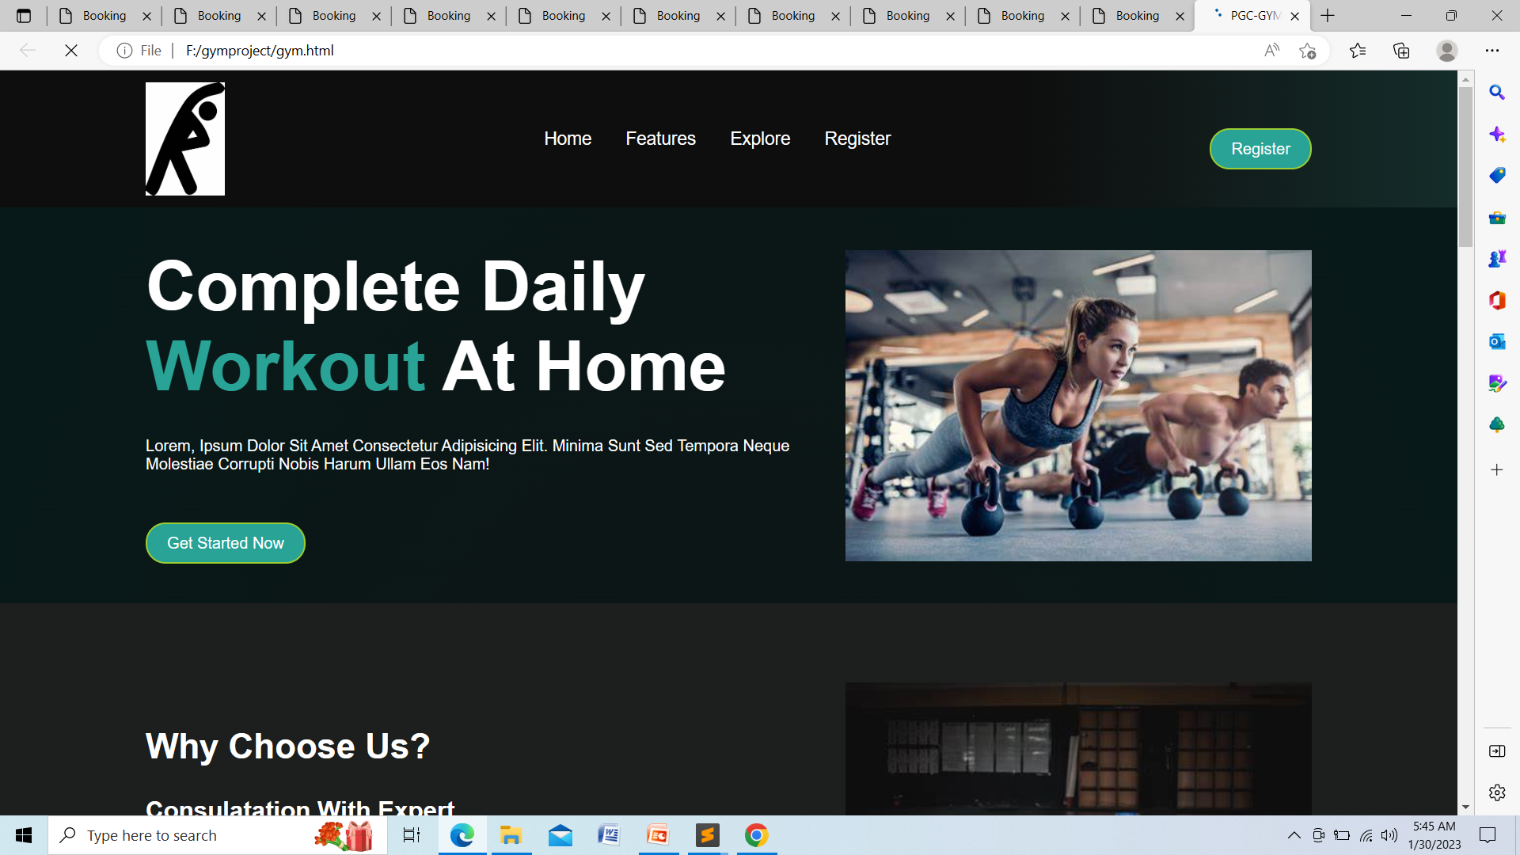
Home Page:

Slide 9
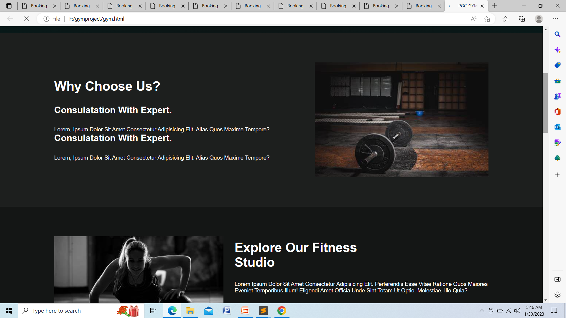
Features:

Slide 10

Explore :

Slide 11
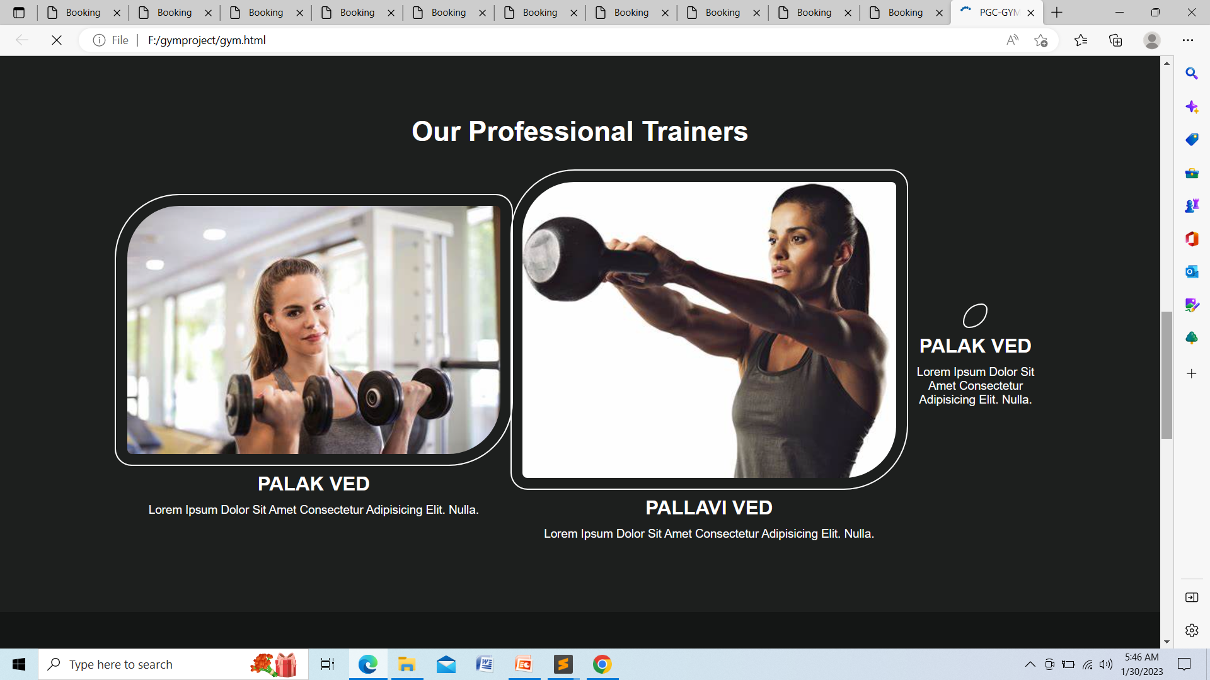
About Trainers:

Slide 12
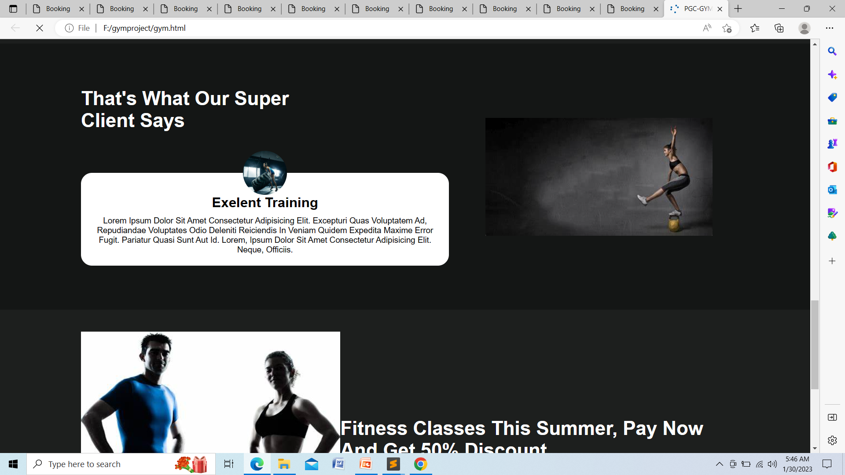
Client:

Slide 13

Link for Booking:

Slide 14
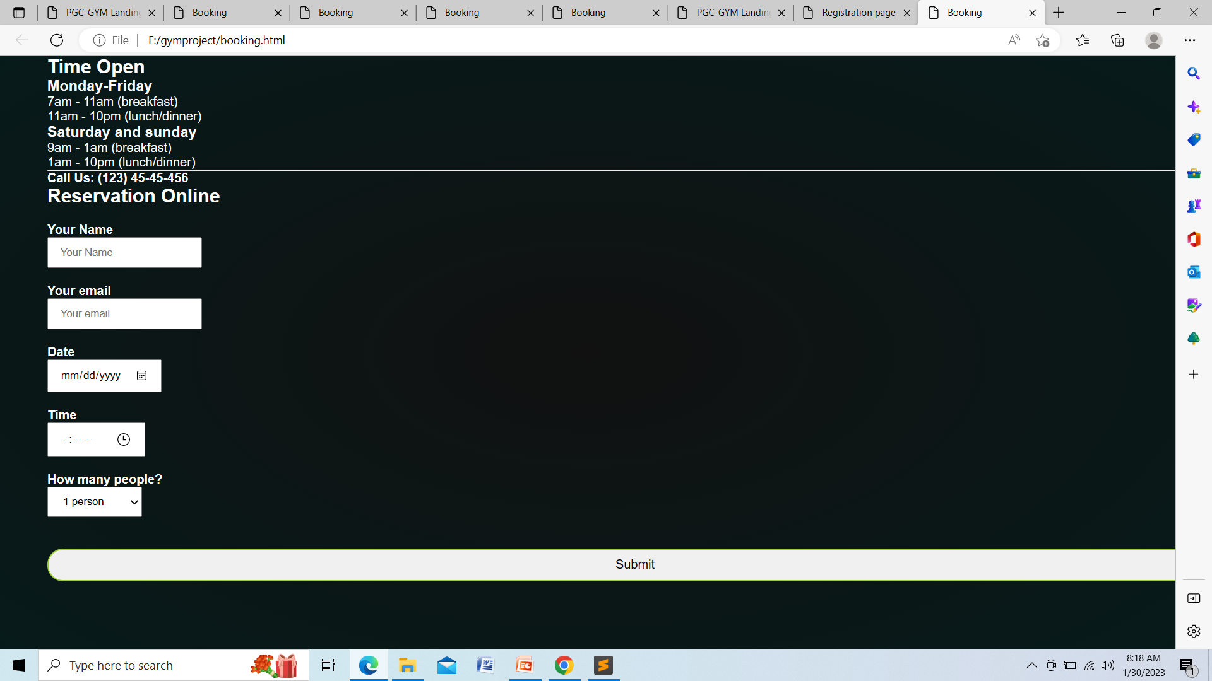
Booking:

Slide 15
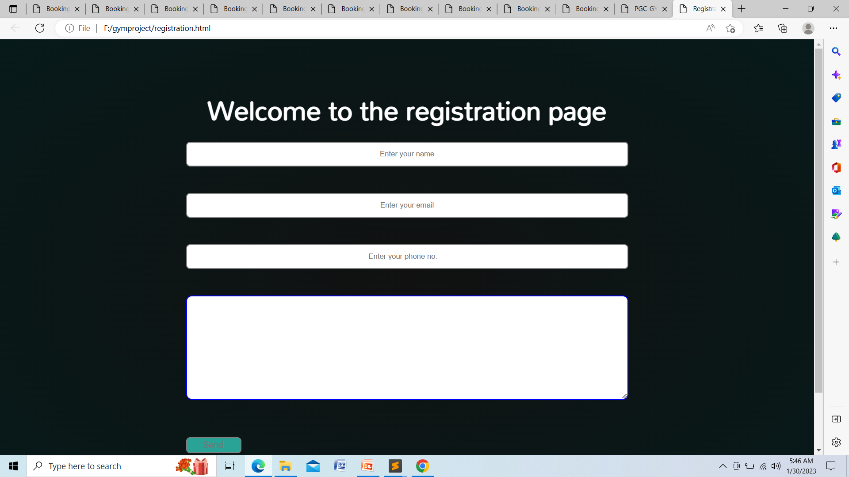
User Register:

Slide 16
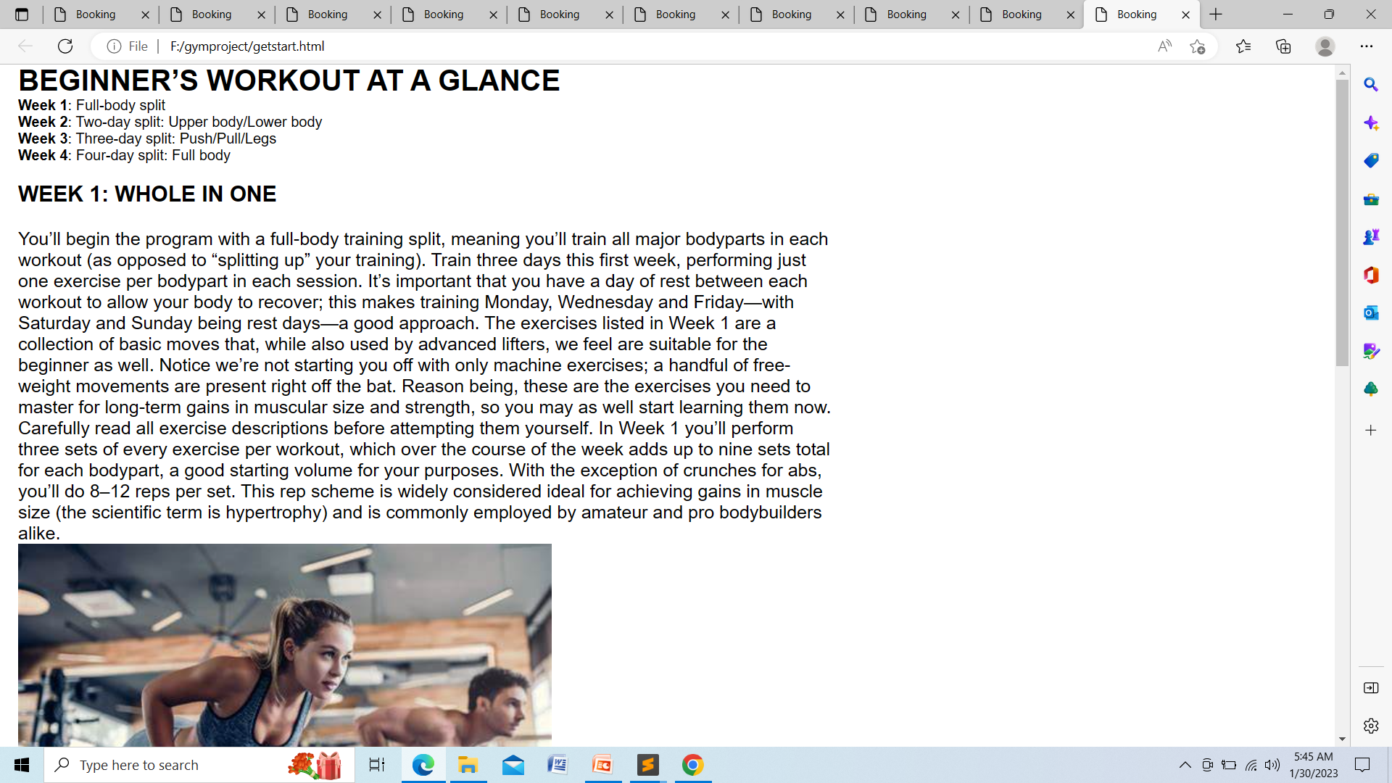
View Week plans:

Slide 17
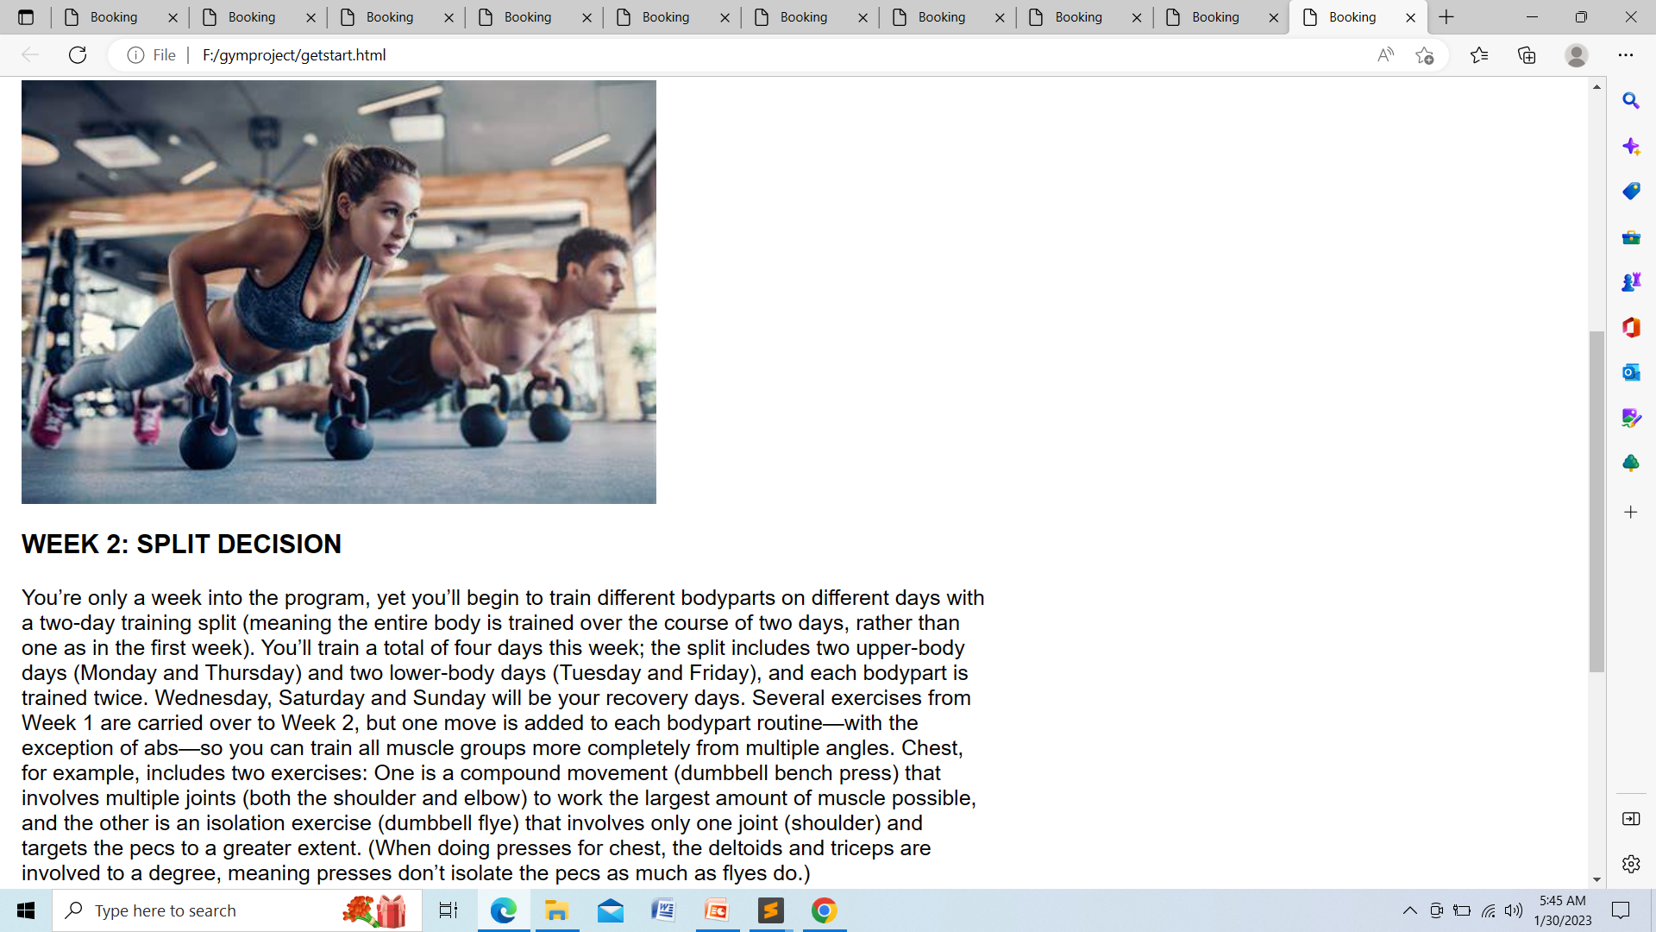

Slide 18
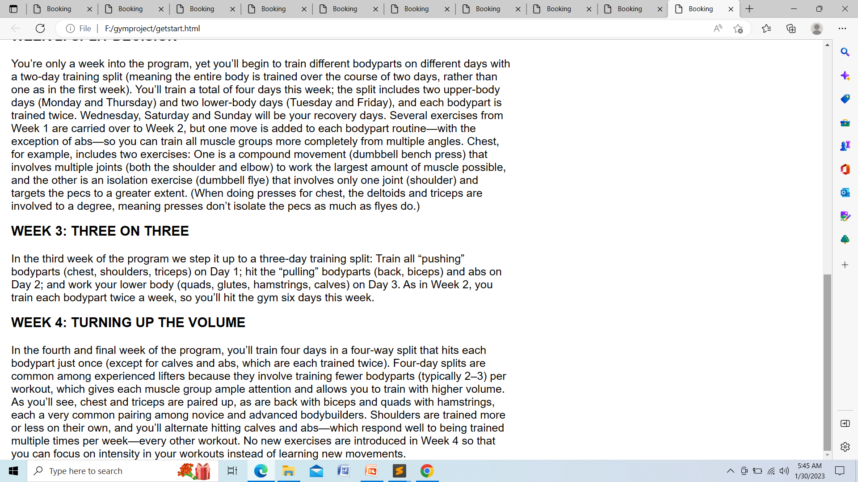

Slide 19

Git hub Link
``
https://github.com/JayaprakashPanabaka/Project-17---Gym-management-System.git

Slide 20
← THANK YOU !! →

